Slide 1
What is Mythology?
Some people use the word myth to mean fake but….

Slide 2
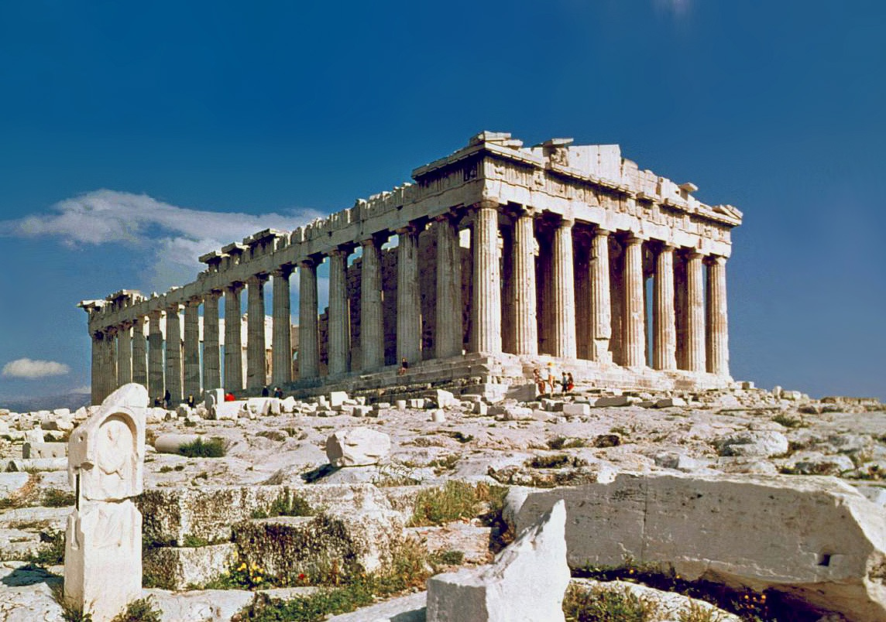
Mythology
Mythology is the study of stories that were used to explain the world and other human experiences.

Slide 3
Greek Myths were used to explain...
the creation of the earth,
death and the afterlife,
and human experiences: love, jealousy, revenge, & war.
They were also used as entertainment and were only told orally because most people could not read.

Slide 4
gods & goddesses
Greek Myths include gods & goddesses.
A god or goddess is immortal. This means that they can never die and that they live forever.
The immortals could not die but they did make mistakes and had human emotions such as: jealousy, love & anger.

Slide 5
How it all began...
Ghea - goddess of the earth
Uranus - god of the sky
From Ghea and Uranus came the the twelve Titans.
Cronos became the ruling Titan with is wife Rhea. Cronos was worried that his kids would become more powerful than him so he ate them all… or so he thought… One child survived… Do you know who it is????
Their kids were the first Olympians.

Slide 6
Meet the Olympians!

Slide 7
Heros
Odysseus: After fighting in a war for 10 years…
He spends 10 more years trying to return home.
Hercules: He is part man, part god. He has to complete 12 very dangerous tasks.

Slide 8
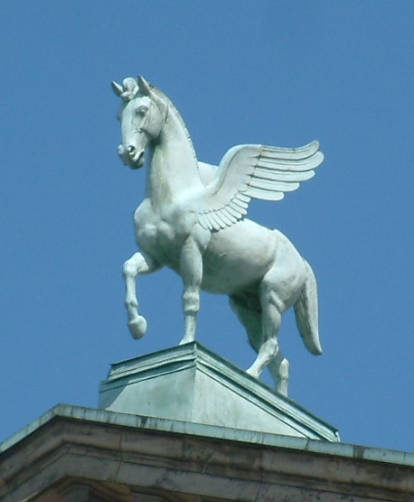
Monsters and other creatures!

Slide 9
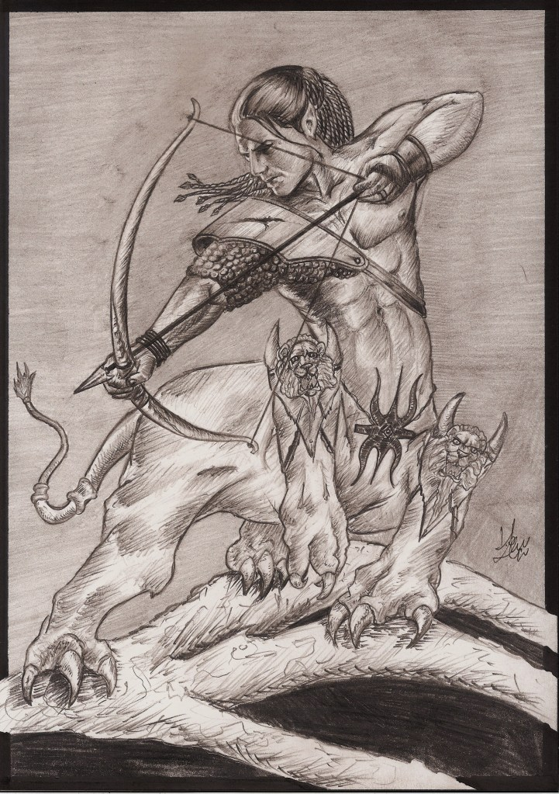
Centars
Half-man, half-horse
Portrayed as aggressive creatures

Slide 10
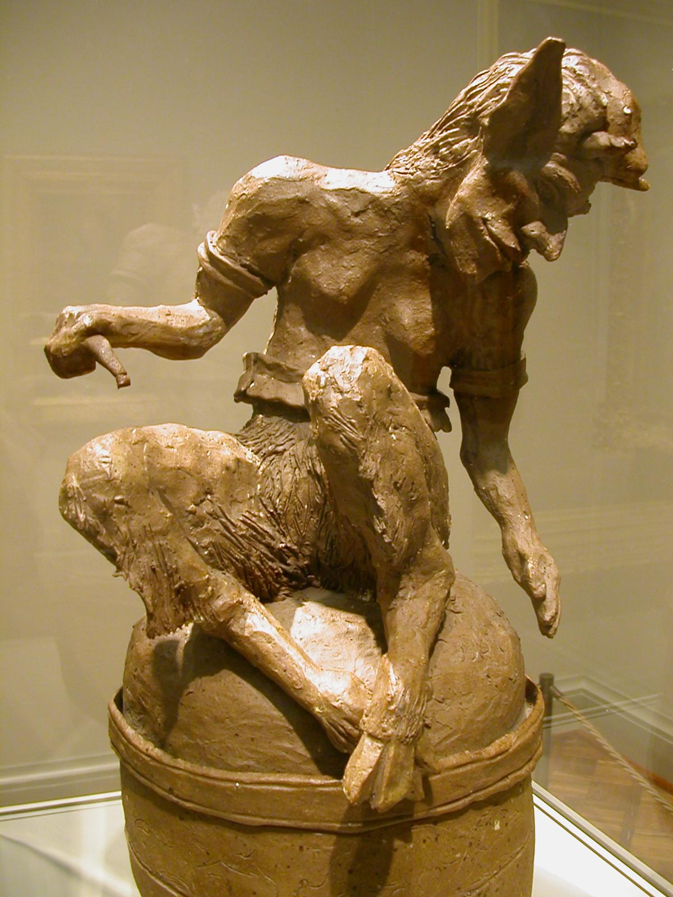
Satyrs
Half-man, half-goat

Slide 11
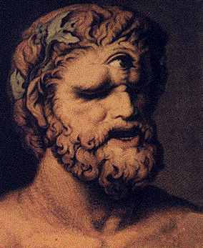
Cyclops
One Eyed Monsters:
The most famous is Polyphemus who fights Odysseus in his cave.

Slide 12
Myths were a way to explain the unexplained...

Slide 13
Today
In our world today there are many references to Greek myths.
Knowing these famous stories and characters will help you to better understand the world around you.
They are also fun to learn!

